Slide 1
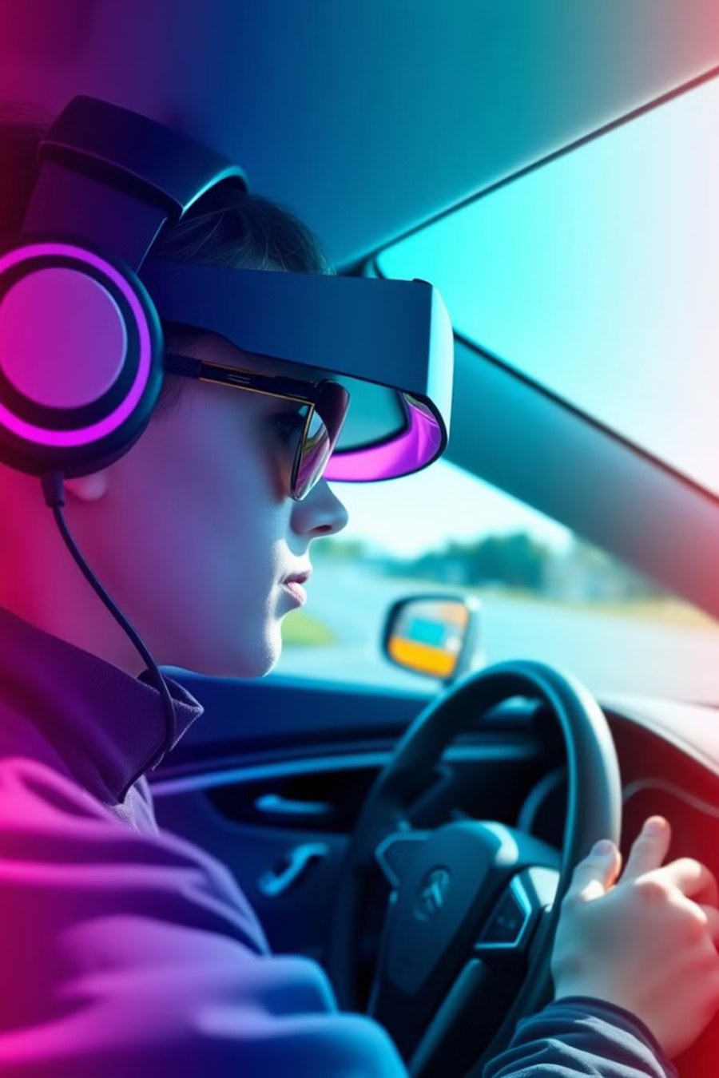
Enhancing Driver Safety Through EEG-Based Drowsiness Detection: A Hybrid Model Using Fuzzy Logic and XGBoost
Presented By, Keerthi Kumar A V 2367409 M.Tech Data Science
Under Guidance of:
Prof. Dr. Vandana Reddy Prof. Dr. Debarka M

Slide 2
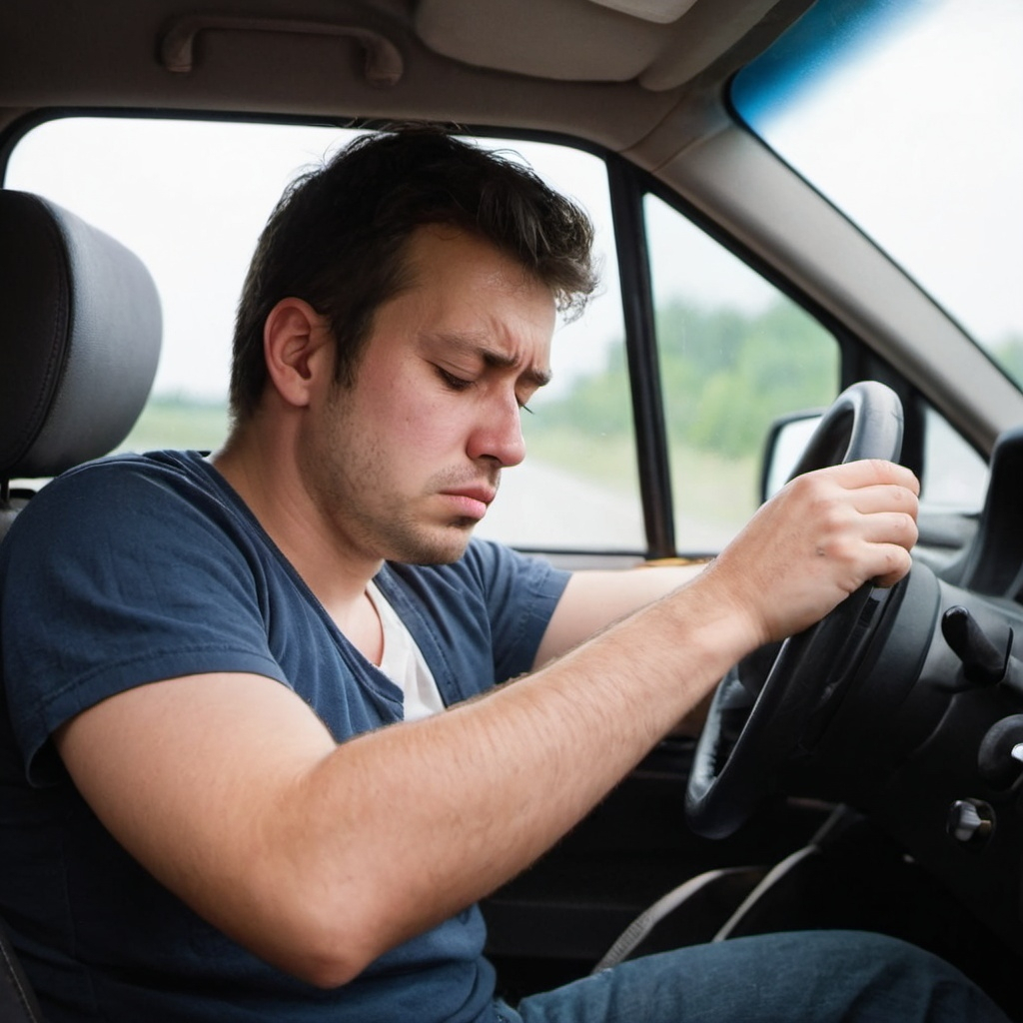
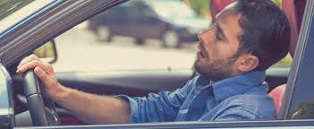
The Silent Threat:
Drowsiness Behind the Wheel
Drowsy Driving:
A Hidden Danger on the Road

Slide 3
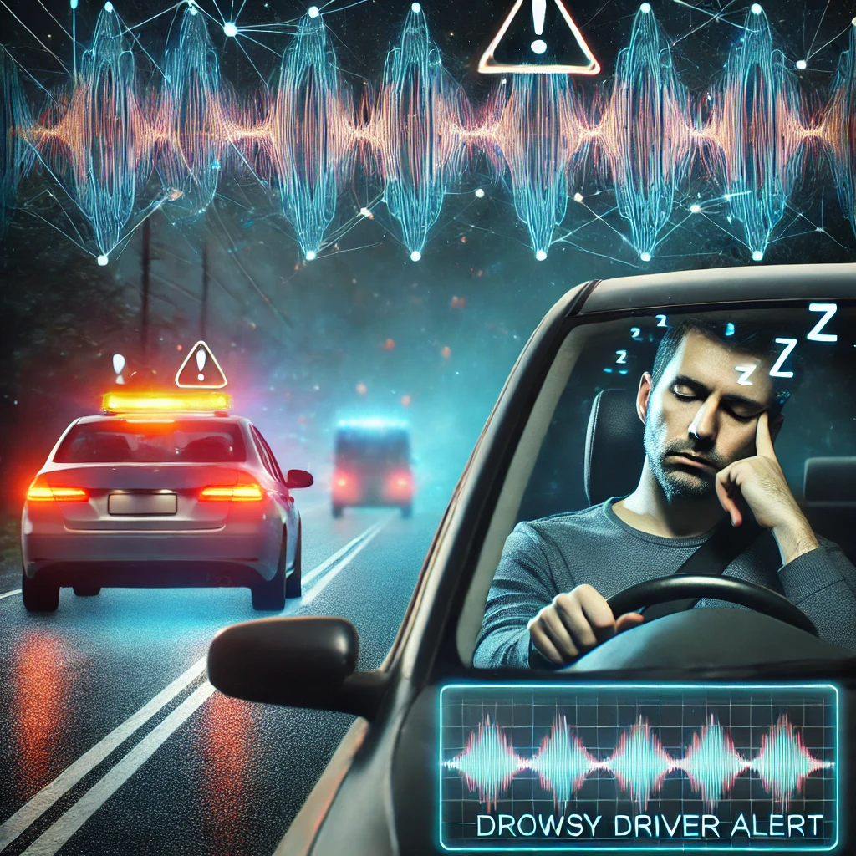
Problem Statement
Driver drowsiness is a leading cause of road accidents, contributing to 20% of crashes worldwide.
Traditional detection systems, such as eye-tracking and physiological sensors, often suffer from low accuracy under varying conditions.
Existing machine learning models struggle with real-time inference due to high computational costs and poor uncertainty handling.

Slide 4
Abstract
Driver fatigue detection is essential for reducing road accidents, and this research proposes a hybrid model using fuzzy logic and XGBoost.
Fuzzy logic addresses uncertainty estimation, while XGBoost ensures accurate and efficient EEG signal analysis.
The model was compared against traditional ML algorithms (SVM, Random Forest, Gradient Boosting) developed with Scikit-learn.
The hybrid model achieved 83% accuracy and a real-time detection speed of 0.138 seconds, outperforming baseline methods.
A pre-processed EEG dataset from Kaggle was utilized, with development and testing performed on Google Colab for convenience.

Slide 5
Introduction
Importance of Drowsiness Detection
A significant cause of road accidents, necessitating effective detection systems.
Challenges in Real-Time Detection
Balancing accuracy and speed in real-time systems is difficult due to human physiology and the need for fast algorithms.
Technological Focus
Fuzzy Logic and ML offer advancements in reducing inference time while maintaining detection reliability.
Research Objective
To compare approaches for real-time drowsiness detection, focusing on finding the optimal balance between speed and accuracy.

Slide 6
How Is Drowsiness As A Cause Of Accidents Determined?
Eyewitness Reports: Witnesses may notice the driver looking tired or drifting before the crash.
Driver Admission: Drivers might admit to feeling drowsy or falling asleep.
Scene Evidence: Lack of skid marks or corrective actions suggests the driver was asleep.
Time of Day: Accidents during late-night or early morning hours are more likely to involve drowsiness.
Behavior Patterns: Erratic driving or drifting between lanes can indicate drowsiness.
Technology: Modern cars may have systems that detect and record signs of driver drowsiness.

Slide 7
Why EEG Signals?
EEG (Electroencephalography) measures the brain's electrical activity, making it a highly reliable source for detecting cognitive states such as drowsiness.
Unlike other physiological signals (such as heart rate or eye movement), EEG directly reflects brain activity, providing earlier and more accurate indicators of fatigue.
Drowsiness is associated with specific brain wave patterns, such as increases in theta (4–8 Hz) and alpha (8–12 Hz) waves, which can be detected through EEG.
EEG-based detection allows real-time monitoring of changes in mental alertness, offering a more precise approach to identifying driver fatigue before it manifests into dangerous behavior, such as micro-sleeps or drifting off the road.

Slide 8
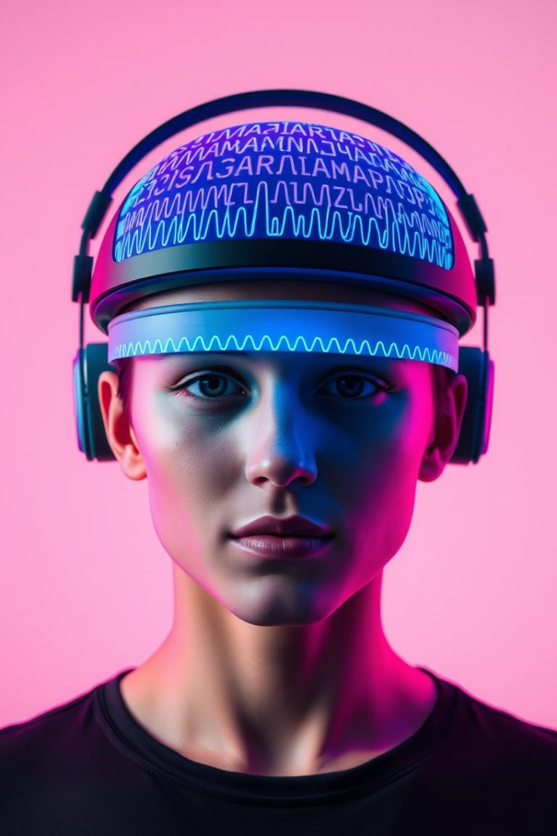
EEG: A Direct Window into the Brain
1
Eye-Tracking
Prone to errors under poor lighting conditions.
2
Physiological Sensors
Less sensitive to cognitive fatigue than EEG.
3
EEG
Directly measures brain activity, offering higher reliability in detecting cognitive fatigue.
EEG provides direct, reliable measurement of brain activity. This offers a more accurate means of assessing cognitive fatigue compared to alternatives.

Slide 9
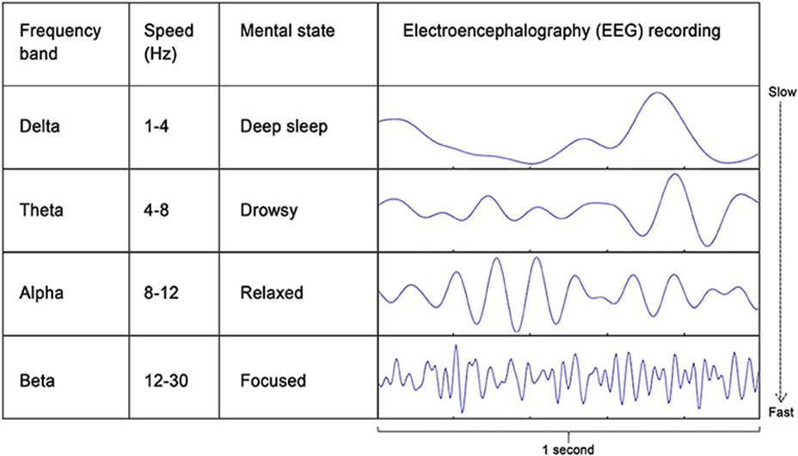
Types Of EEG Signals

Slide 10
Consolidated Gap Analysis
Lack of Comparative Studies:
Insufficient studies comparing inference times and accuracy across various models.
Limited Practical Implementation of Hybrid model of Fuzzy and Machine Learning:
real-world application remains largely unexplored.
Real-Time Focus:
Most research prioritizes accuracy over real-time responsiveness.
Multimodal Integration Challenges:
Difficulties in synchronizing multiple data streams for effective real-time detection.

Slide 11
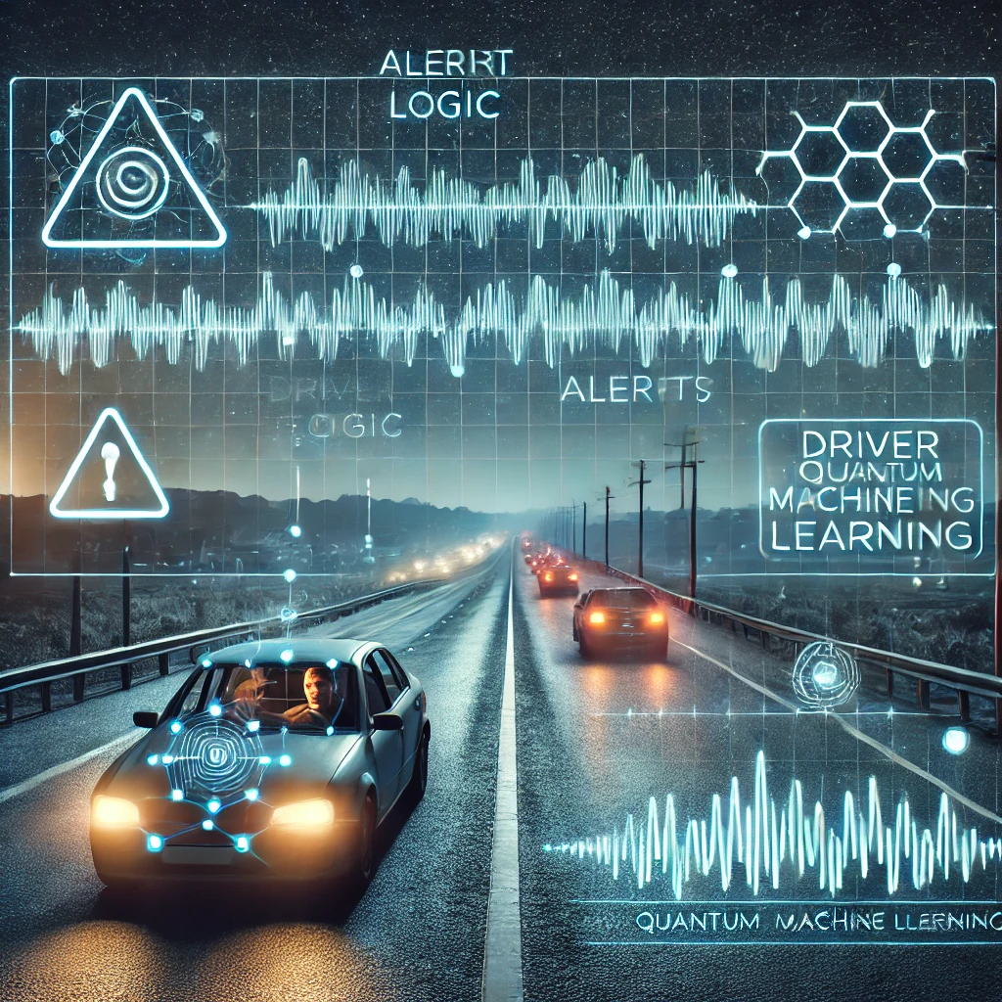
Solution To Global Issue
Drowsiness during driving causes accidents; existing systems lack real-time accuracy and responsiveness.
To address this, we propose a hybrid approach to balance both accuracy and inference time by combining Fuzzy Logic for uncertainty estimation and XGBoost for efficient EEG-based classification.
This model aims to improve both detection accuracy and real-time responsiveness, ensuring safer driving conditions

Slide 12
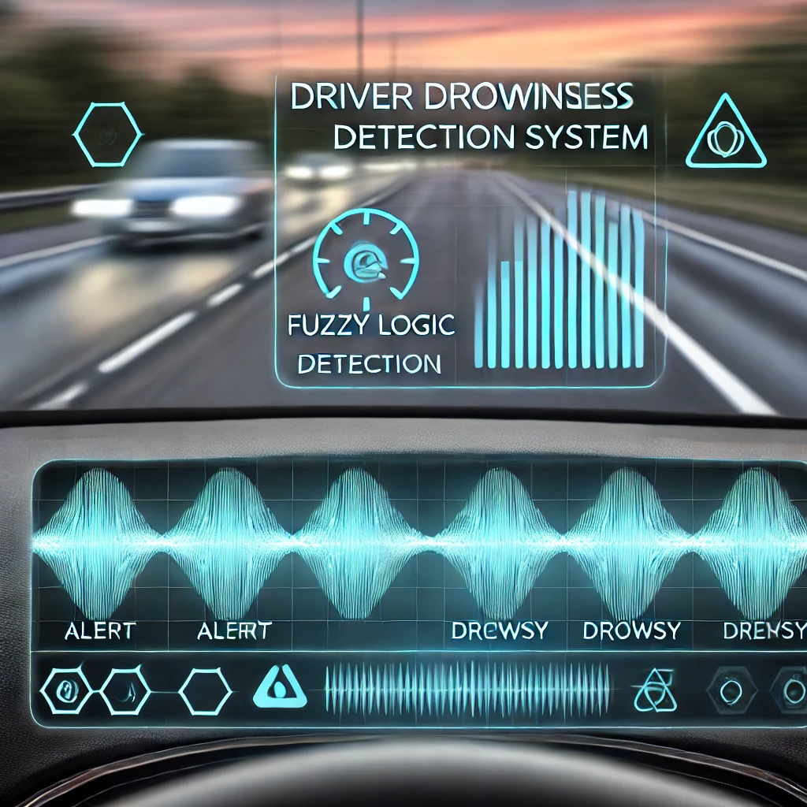
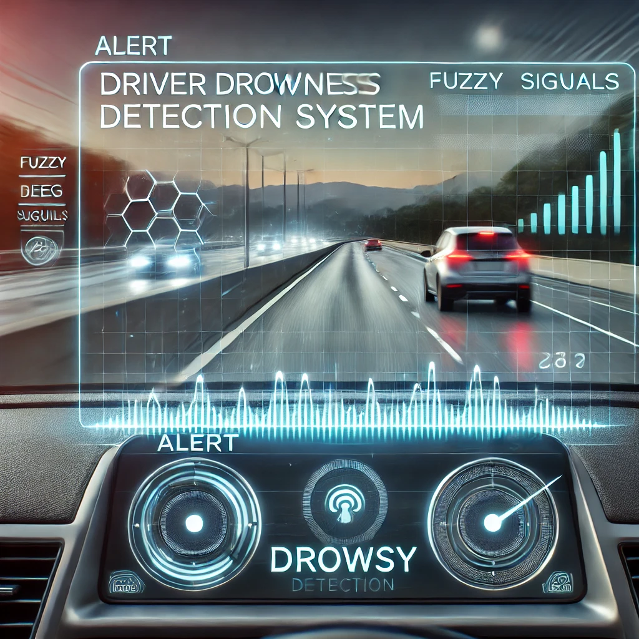
Enhancing Driver Safety Through EEG-Based Drowsiness Detection
A Hybrid Approach Using Fuzzy Logic and XGBoost

Slide 13





Research Objectives Defined
Hybrid Model Development
Performance Improvement
Benchmark Against Baselines
Signal Optimization
Optimize preprocessing to boost feature extraction.
Develop an EEG-based drowsiness detection model.
Enhance accuracy and speed for real-time use.
Compare with SVM, Random Forest, KNN.
This research seeks to create a highly effective drowsiness detection system.
This is achieved by integrating advanced machine learning techniques with EEG signal processing.

Slide 14
Objectives
Develop a Real-Time Drowsiness Detection System
Create an efficient system that detects drowsiness in drivers using EEG signals in real-time to prevent accidents.
Compare Traditional and Advanced Machine Learning Models
Design a Hybrid Model
Evaluate and compare the performance of traditional machine learning models (e.g., SVM, Random Forest, etc.) with advanced techniques such as XGBoost and Fuzzy Logic.
Develop a hybrid model combining Fuzzy Logic and XGBoodt to achieve an optimal balance between detection reliability (accuracy) and computational efficiency (inference time).
Optimize Inference Time
Implement and test the models to minimize inference time while maintaining high accuracy, ensuring that the system can respond instantly to driver drowsiness.
Integrate Fuzzy Logic for Handling Uncertainty
Utilize Fuzzy Logic to manage uncertainty and imprecision in EEG data, allowing for more adaptive and flexible drowsiness detection across different driving conditions.
Notes:
Objectives:
Develop a Real-Time Driver Drowsiness Detection System:
Design and implement a system that detects driver drowsiness using EEG signals.
Ensure the system provides real-time alerts to prevent accidents by processing data quickly.
Leverage a Hybrid Fuzzy Logic Approach:
Combine fuzzy logic with traditional machine learning techniques to improve detection accuracy and responsiveness.
Use fuzzy logic to handle uncertainty and imprecision in EEG data, making the detection system more adaptable.
Optimize the Balance Between Speed and Accuracy:
Develop algorithms that optimize both the speed and accuracy of drowsiness detection.
Focus on reducing inference time while ensuring reliable predictions to enhance real-time system performance.
Enhance System Adaptability:
Ensure that the hybrid fuzzy logic system adapts to various environmental conditions and driver behaviors.
Test and refine the system to handle different levels of drowsiness and physiological variations.
Evaluate Performance Against Traditional Models:
Compare the hybrid fuzzy approach to traditional machine learning models (e.g., SVM, Random Forest, XGBoost) based on key metrics like accuracy, precision, recall, F1 score, and inference time.
Analyze areas where the hybrid approach provides improvements over standard models in real-time applications.
Contribute to the Advancement of Drowsiness Detection Systems:
Provide practical insights into the implementation of hybrid fuzzy systems for real-time drowsiness detection.
Lay the groundwork for future research and development in enhancing driver safety through advanced detection systems.

Slide 15
Implementations Of Objectives
Develop a Real-Time Drowsiness Detection System
Preprocessed EEG data and developed a real-time monitoring system.
Compare Traditional and Advanced Machine Learning Models
Evaluated SVM, Random Forest, XGBoost, and Fuzzy Logic models.
Optimize Inference Time
Applied PCA for dimensionality reduction and hyperparameter tuning to improve speed.
Integrate Fuzzy Logic for Handling Uncertainty
Developed a Fuzzy Inference System (FIS) to manage uncertainty in EEG signals.
Design a Hybrid Model
Combined Fuzzy Logic and XGBoost to balance detection accuracy and speed.

Slide 16
Methodology and System Architecture
Acquisition
Extraction
EEG Signal Acquisition
Feature Extraction
1
2
3
4
Preprocessing
Classification
Signal enhancement through noise filtering and artifact removal.
Drowsiness classification via Fuzzy Logic and XGBoost.
The architecture integrates Fuzzy Logic for handling uncertainty and XGBoost for
optimized classification. Comparative baselines ensure robustness.

Slide 17
Methodology
Data Collection & Preprocessing
1
Utilized pre-processed EEG dataset from Kaggle
Extracted key features (e.g., alpha, beta, theta waves)
Optimization
2
Applied dimensionality reduction (PCA) and Tune hyperparameters for XGBoost model.
Model Selection
3
Trained traditional machine learning models (SVM, Random Forest, Extra Trees Classifier, Gradient Boosting Classifier, AdaBoost Classifier).
4
Hybrid Model Development
Developed a fuzzy logic to manage uncertainty
Combined fuzzy logic with XGBoost model
Model Evaluation
5
Balance accuracy and inference time
Evaluated models based on accuracy, precision, recall, F1-score, ROC-AUC, and inference time
6
Comparison & Analysis
Compared traditional models (SVM, Random Forest, Extra Trees Classifier, Gradient Boosting Classifier, AdaBoost Classifier) and hybrid model performance

Slide 18
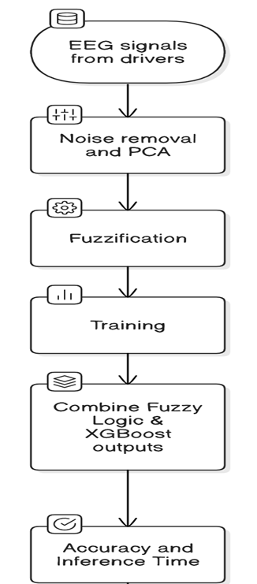
Architecture

Slide 19
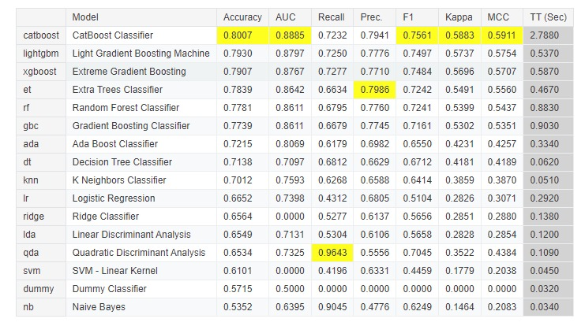
Preliminary Results
Classical Machine Learning Models:
The dataset has already been used to train and evaluate classical machine learning models such as Support Vector Machine (SVM), K-Nearest Neighbors (KNN), and Random Forest. These models have provided baseline accuracy metrics for drowsiness detection, which will now serve as a benchmark for evaluating the Fuzzy Logic and XGBoost model.

Slide 20
Result of Hybrid Model
Model | Accuracy | Precision | Recall | F1 Score | ROC AUC | Inference Time (seconds)
XGBoost (Fuzzy Hybrid) | 0.834 | 0.805 | 0.79 | 0.797 | 0.827 | 0.138
Extra Trees | 0.809 | 0.782 | 0.744 | 0.763 | 0.799 | 0.65
Gradient Boosting | 0.793 | 0.764 | 0.722 | 0.742 | 0.782 | 1.451
Random Forest | 0.784 | 0.759 | 0.702 | 0.729 | 0.772 | 1.652
AdaBoost | 0.719 | 0.667 | 0.641 | 0.653 | 0.707 | 0.749
SVM | 0.695 | 0.598 | 0.803 | 0.685 | 0.711 | 0.543

Slide 21
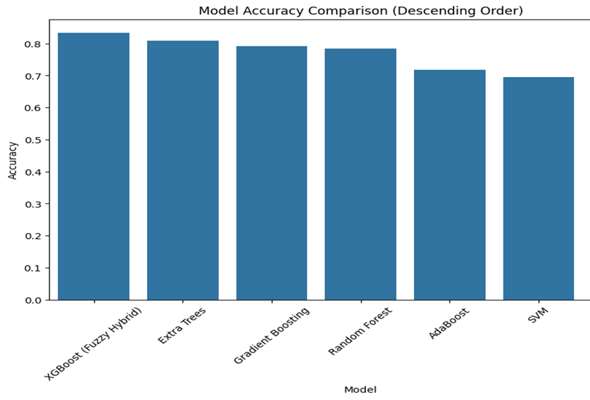
Accuracy Comparision

Slide 22
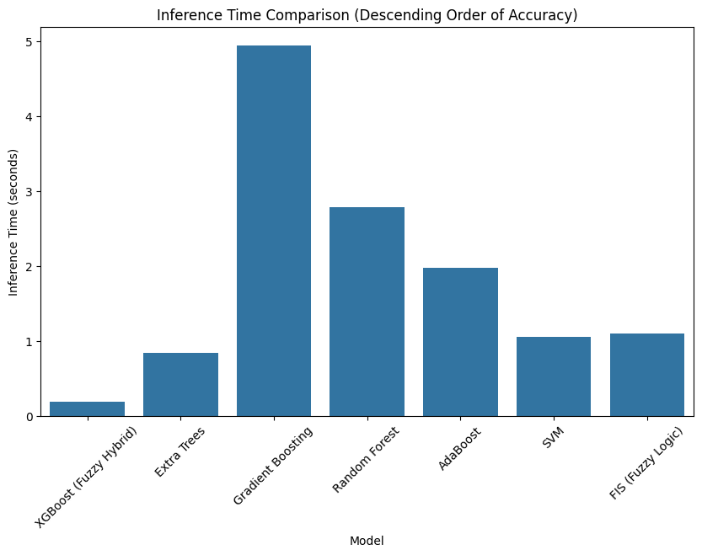
Inference Comparision

Slide 23
Conclusion
Enhanced Driver Safety
This research successfully leverages EEG data to detect driver drowsiness, applying a hybrid approach that combines fuzzy logic with XGBoost for better performance.
Optimized Detection
Through the integration of advanced techniques, the system achieved a balance between speed and accuracy, essential for real-time applications in road safety.
Future Directions
With promising preliminary results, future work will focus on further optimizing inference time and expanding the dataset for more robust real-world application.
Broader Impact
This system not only addresses a critical road safety issue but also opens up new avenues for using EEG data in other cognitive state monitoring scenarios, ensuring wider applications beyond drowsiness detection.

Slide 24




Key Conclusions and Impact
1
Performance
2
Real-Time
3
Accuracy
4
Cognitive Detection
EEG-based monitoring extends to other cognitive applications. These include aviation, healthcare, and autonomous vehicles, improving safety standards.

Slide 25
Future Research Directions
1
Expand Dataset
2
Optimization
3
Vehicle Integration
4
Multimodal Fusion
Future steps will expand the dataset, optimize inference time, and integrate with ADAS,
enhancing accuracy via multimodal fusion.

Slide 26
Future Scope
Real-World Testing:
Data Diversity:
Model Optimization:
Real-Time Implementation:
This dataset was controlled, and while this is a good thing, it also may not reflect real-world driving conditions. The model needs to be tested on larger, more diverse datasets gathered from real-world driving environments in future work.
Other forms of data (different types of drivers, such as younger age groups, less experienced drivers, and driving in different situations) can be used to generalize the model and enhance its robustness.
Initial optimization of the hybrid model may be achieved by tuning of the fuzzy logic framework as well as exploration of alternate machine learning algorithms.
The hybrid model presented can be a natural focus of future studies to deploy this model in real-time systems and to make sure it supports low latency and high reliability in live driving scenarios.

Slide 27
Bibliography
Almirón, R., et al. (2024). "Preventive Detection of Driver Drowsiness from EEG Signals Using Fuzzy Expert Systems." Journal of Medical Systems.
Xiang, C., Fan, X., Bai, D., Lv, K., & Lei, X. (2024). "A Resting-State EEG Dataset for Sleep Deprivation." Scientific Data.
Nabila, W. N. S., Amalin, N. Z., Ammar, M. A., & Zulkufli, N. L. (2024). "EEG-based Sleep Deprivation Classification: A Performance Analysis of Channel Selection on Classifier Accuracy." International Journal on Perceptive and Cognitive Computing.
Jiao, Y., et al. (2024). "Multimodal Drowsiness Detection Using EEG, EOG, and Behavioral Data." IEEE Sensors Journal.
Galera, A., et al. (2024). "Detection of Drowsiness Through the Use of Machine Learning Algorithms on Biosignals." Sensors.

Slide 28
Thank You

